Slide 1

IMDB Movie Dataset Analysis
By: Grant Doyle

Slide 2

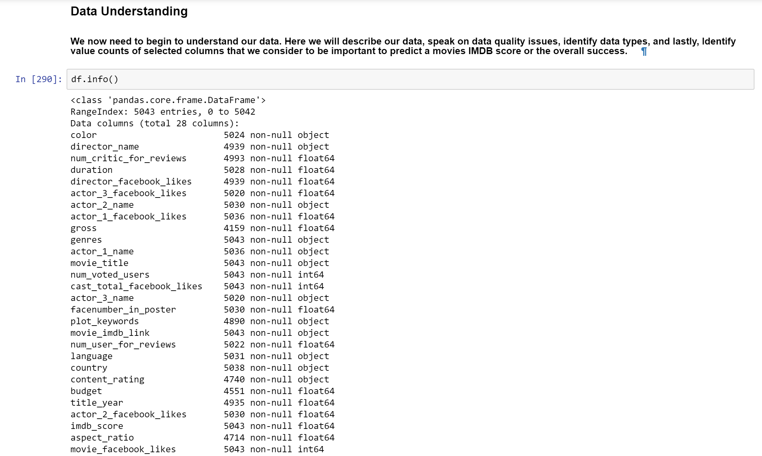
Learning the dataset
Columns not having the same amount of values means missing data.

Slide 3
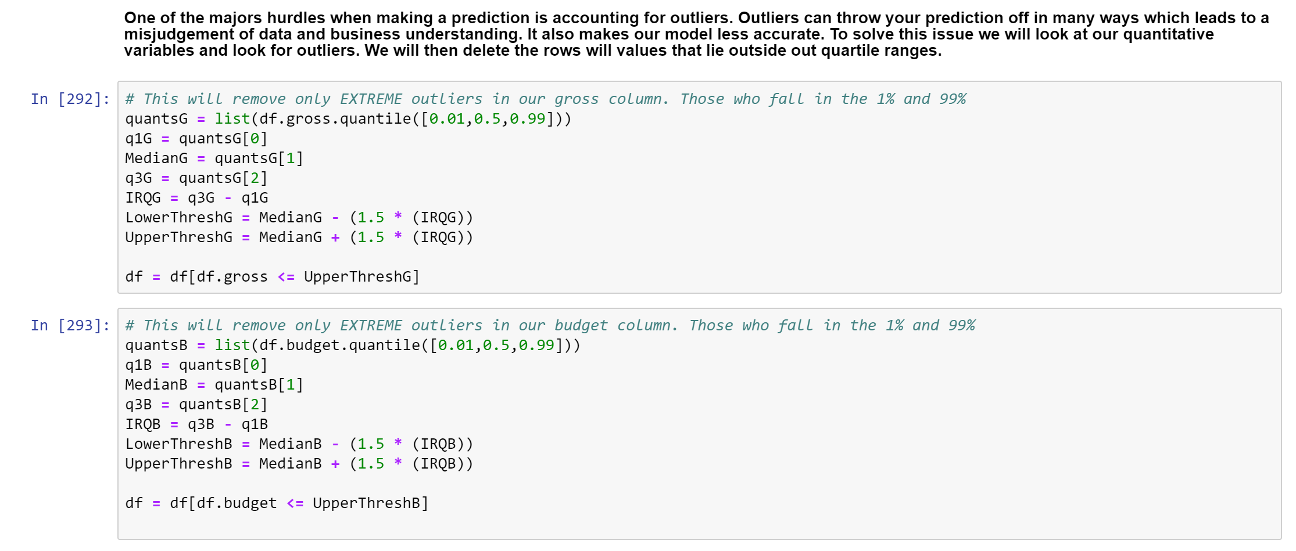
Determining Outliers

Slide 4
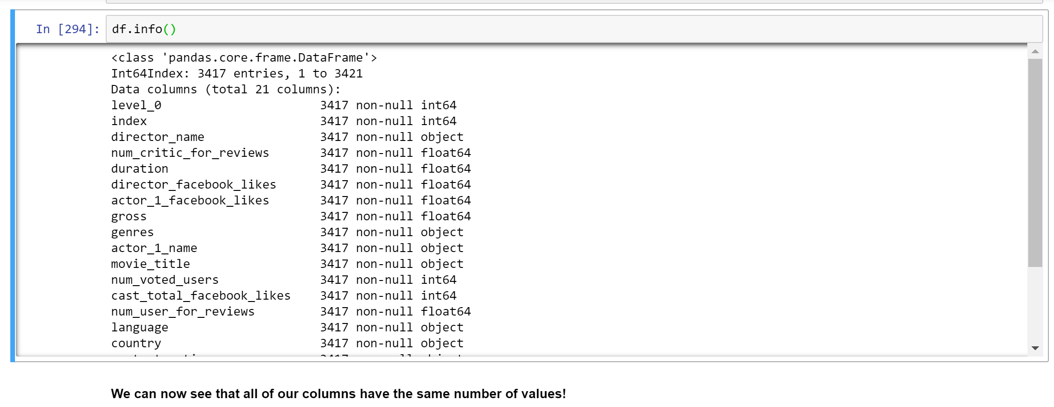
Column values are now the same

Slide 5
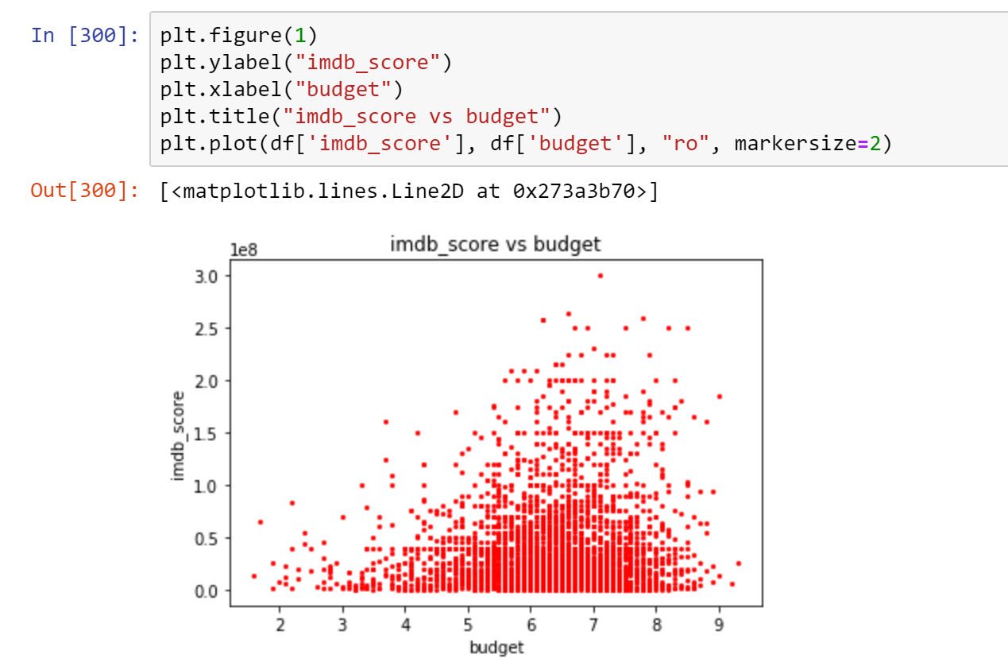
Budget Vs. Imdb

Slide 6
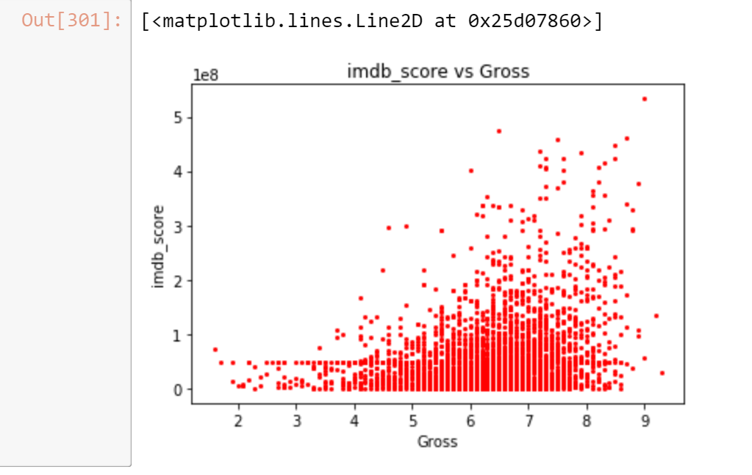
Gross Vs. Imdb

Slide 7
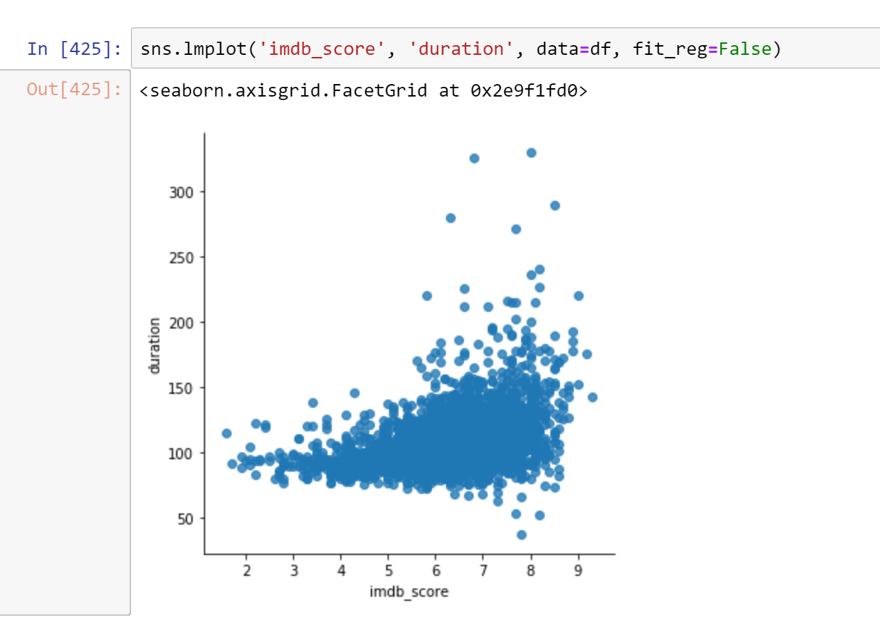
Duration and Imdb Correlation

Slide 8
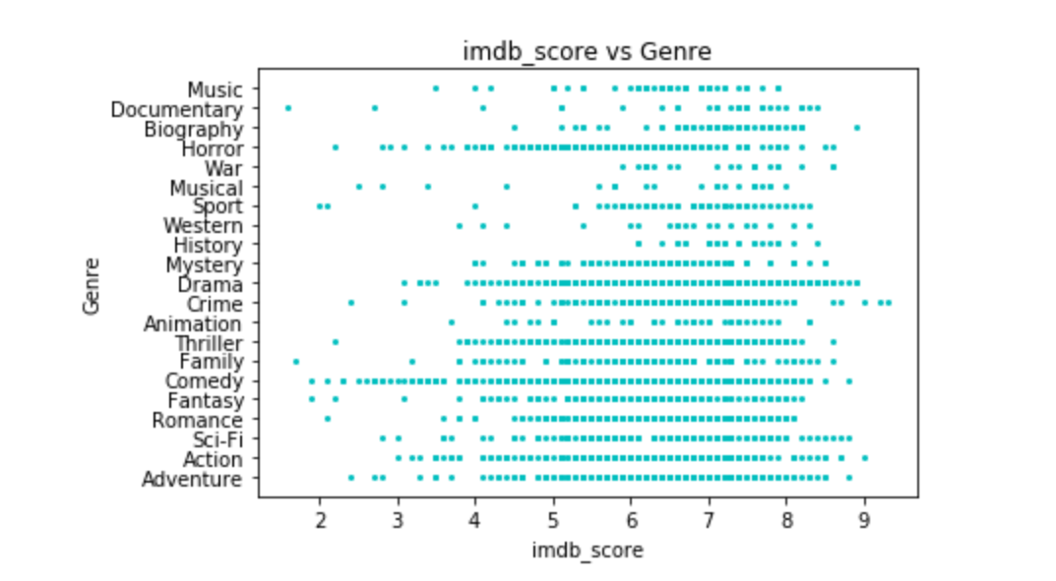
Genre Performance

Slide 9
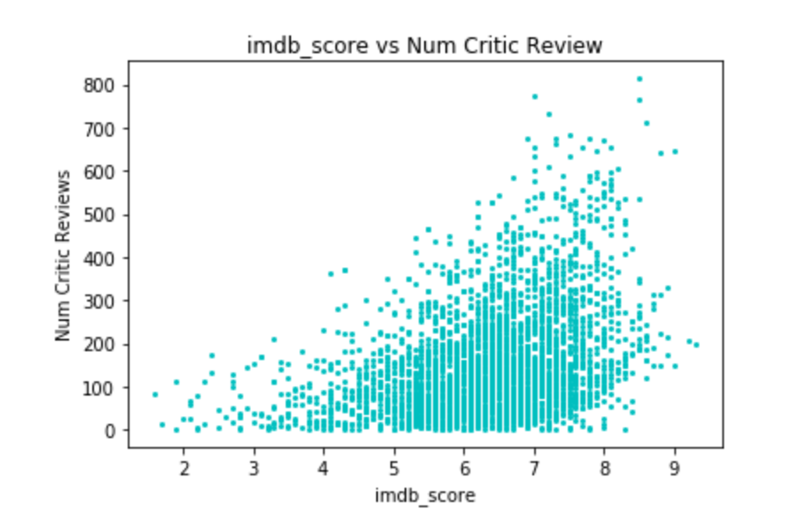
Number of critic reviews Vs. Imdb

Slide 10
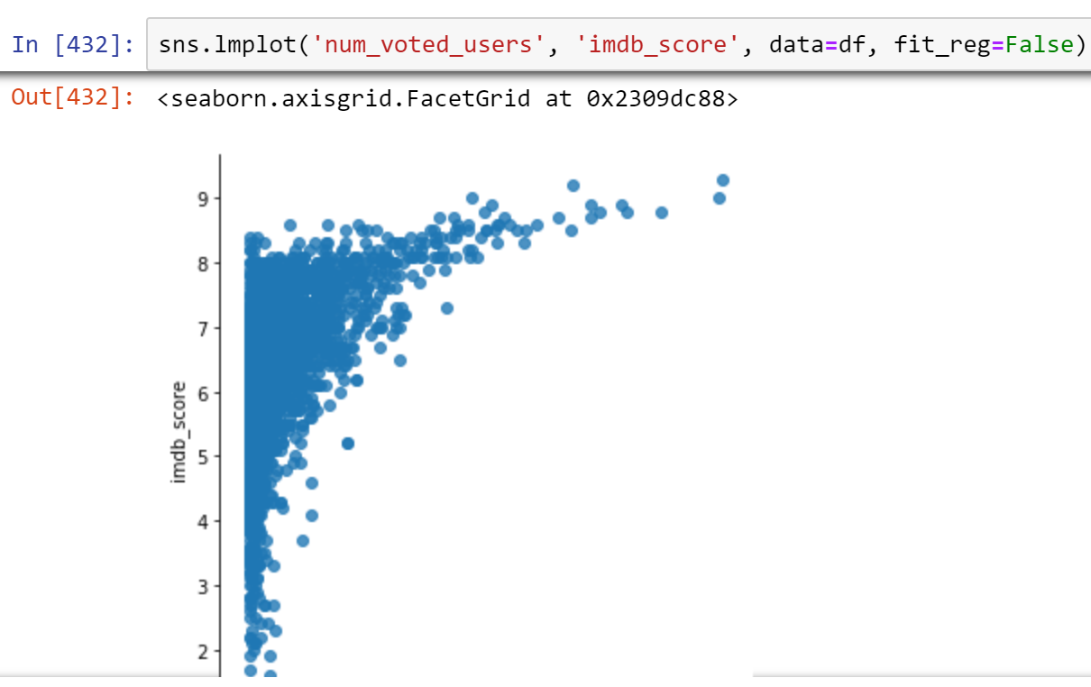
Number of voters Vs. Imdb

Slide 11
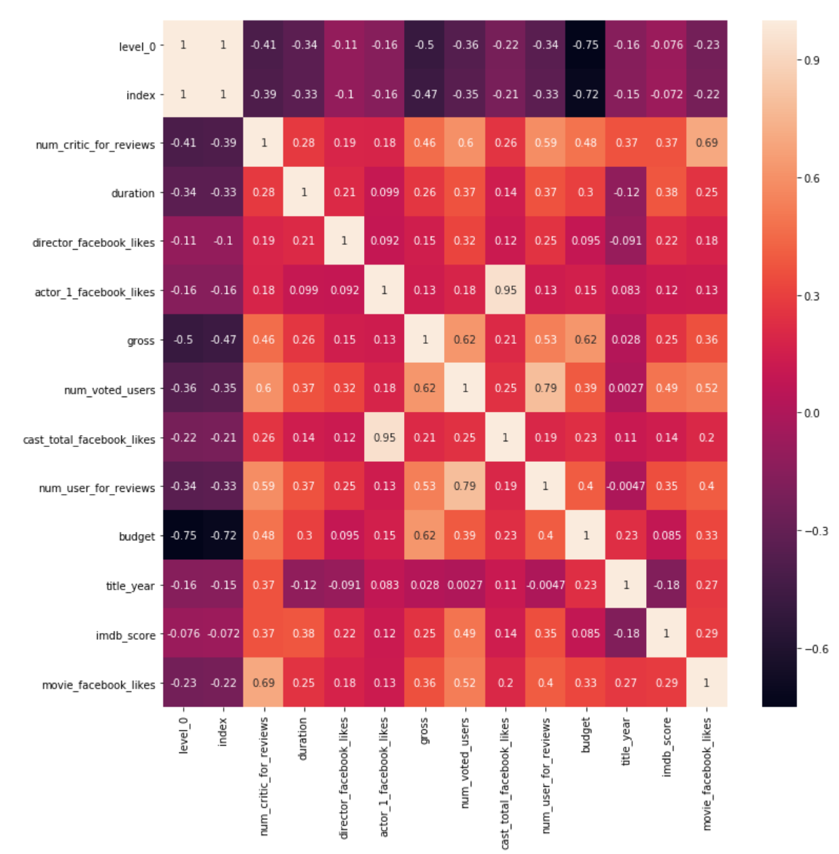
Total dataset correlation heat map

Slide 12
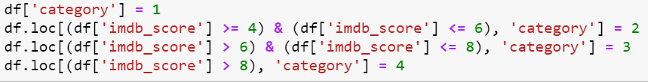
Creating Category Bins

Slide 13
Dropping columns deemed “Unnecessary”

Slide 14
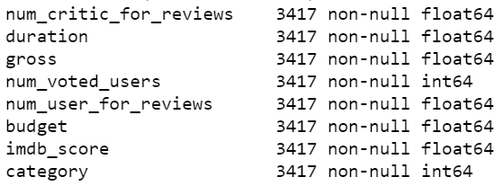
Columns we are left with

Slide 15
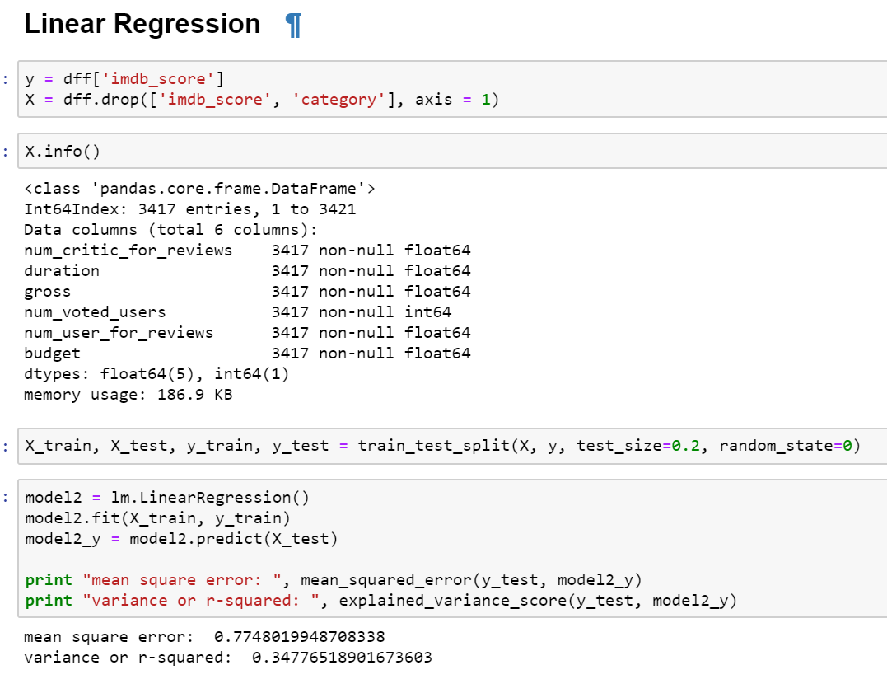
Beginning Regression

Slide 16
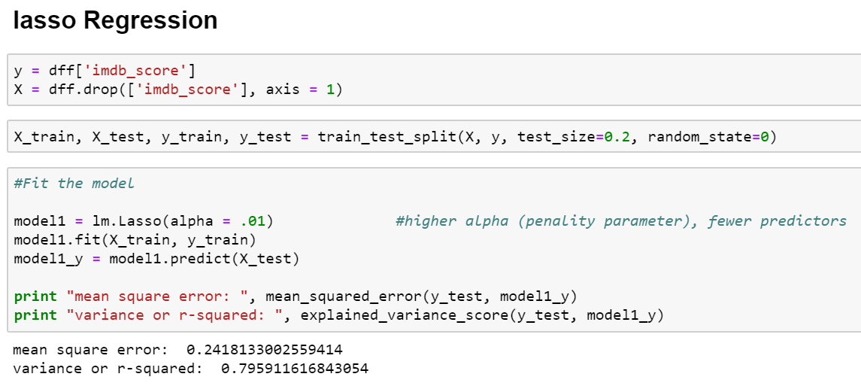
Lasso

Slide 17
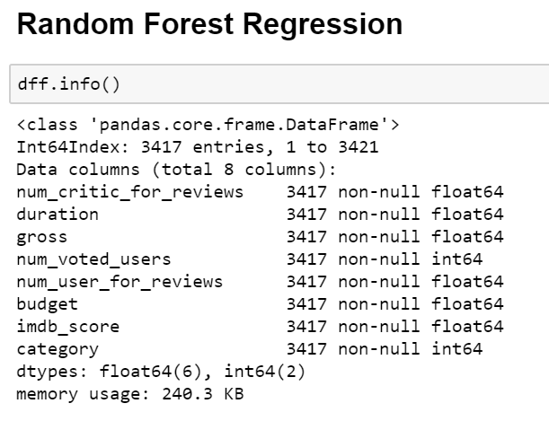
Random Forest Regression

Slide 18
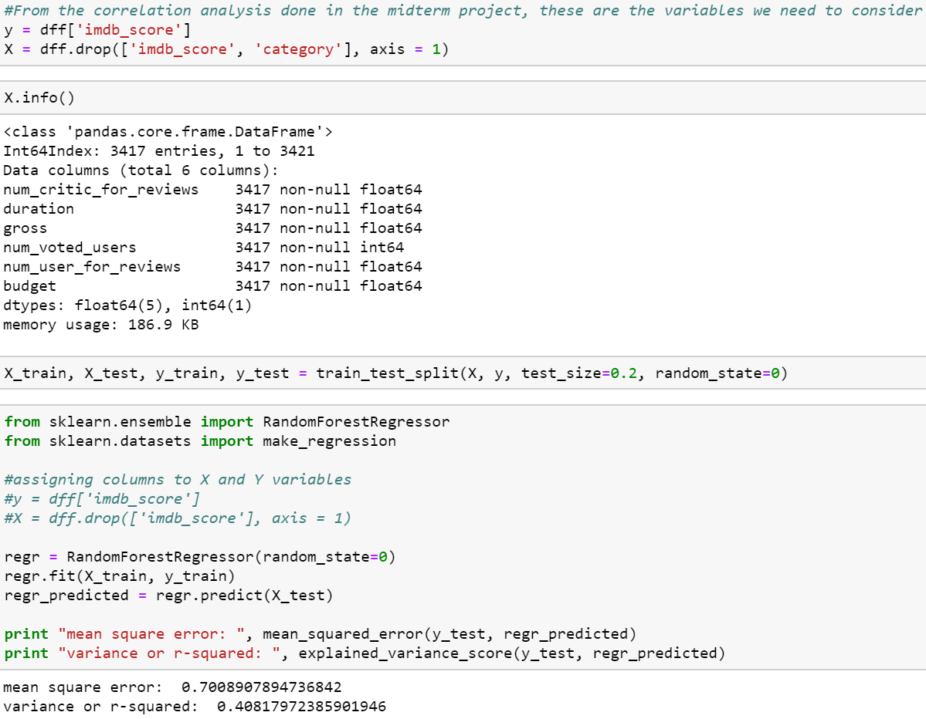
Random Forest Cont.

Slide 19
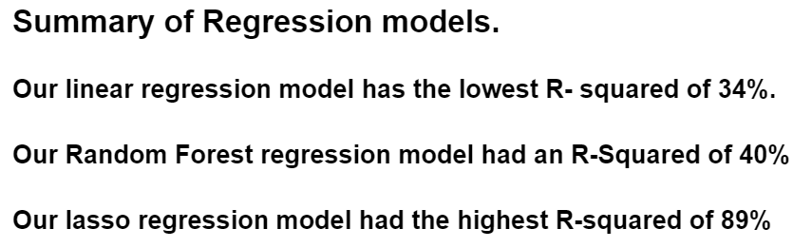
Summary

Slide 20
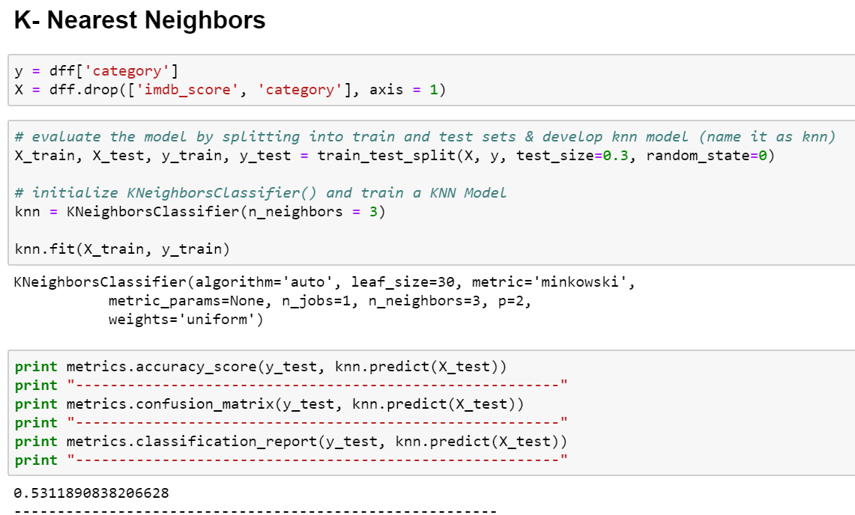
KNN Classifier model

Slide 21
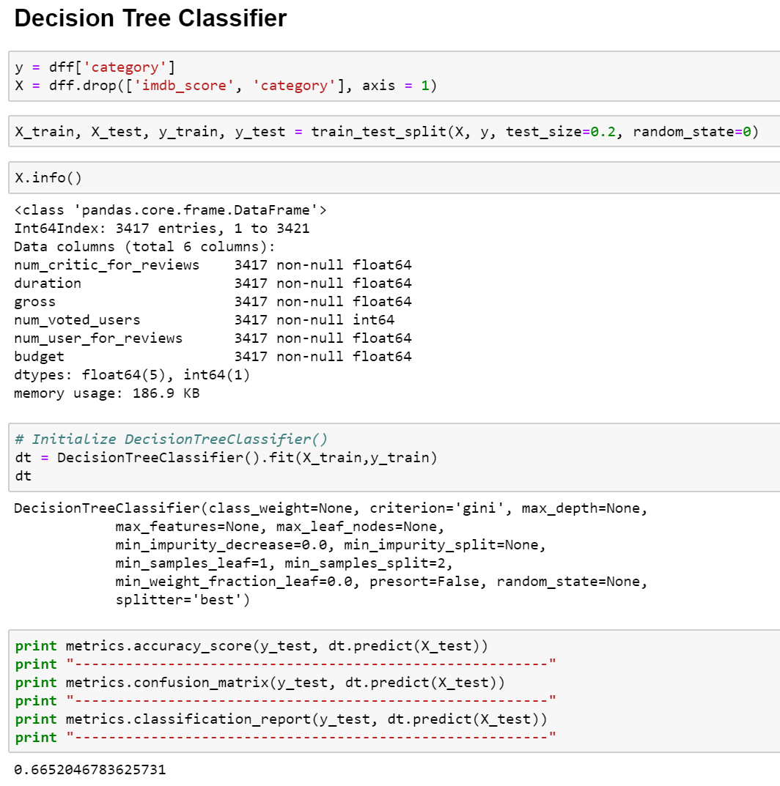
Decision Tree Classifier

Slide 22
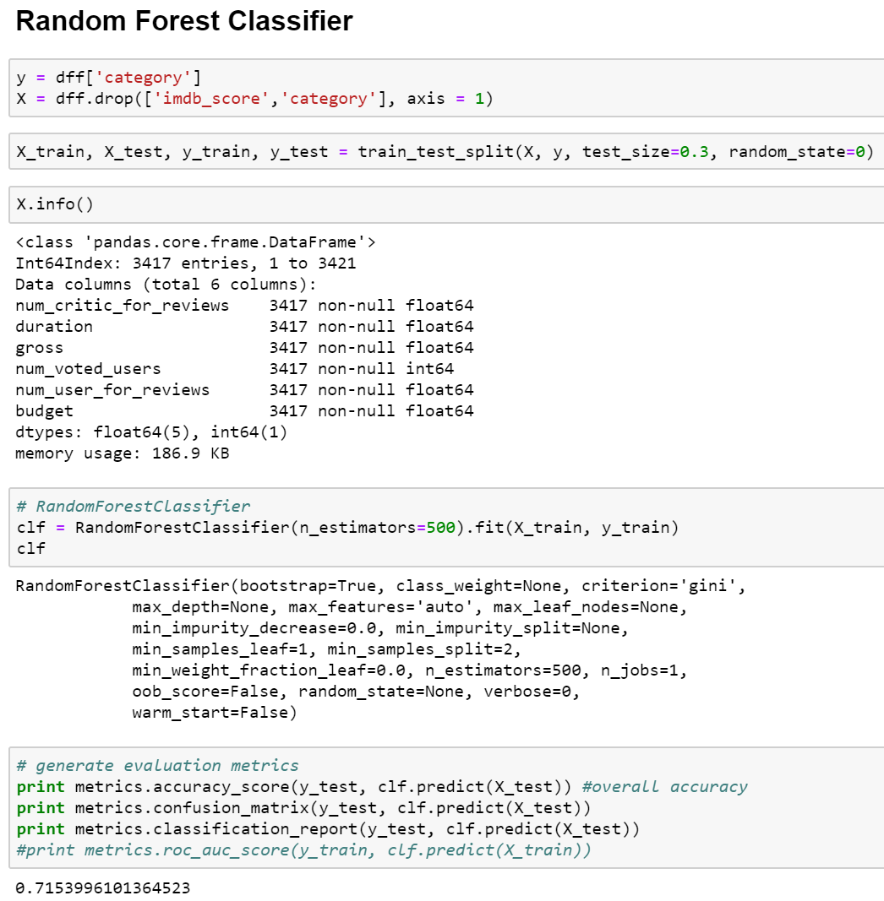
Random Forest Classifier

Slide 23
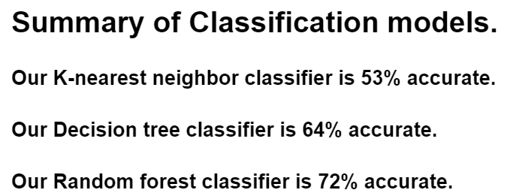
Summary

Slide 24
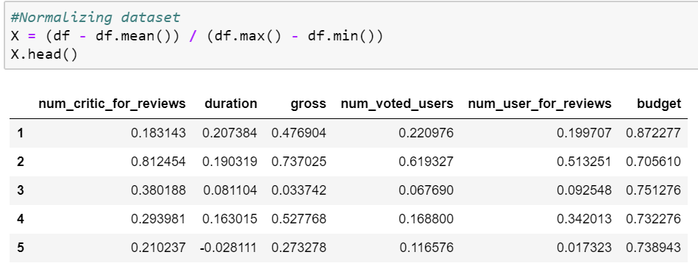
Beginning to Clustering

Slide 25
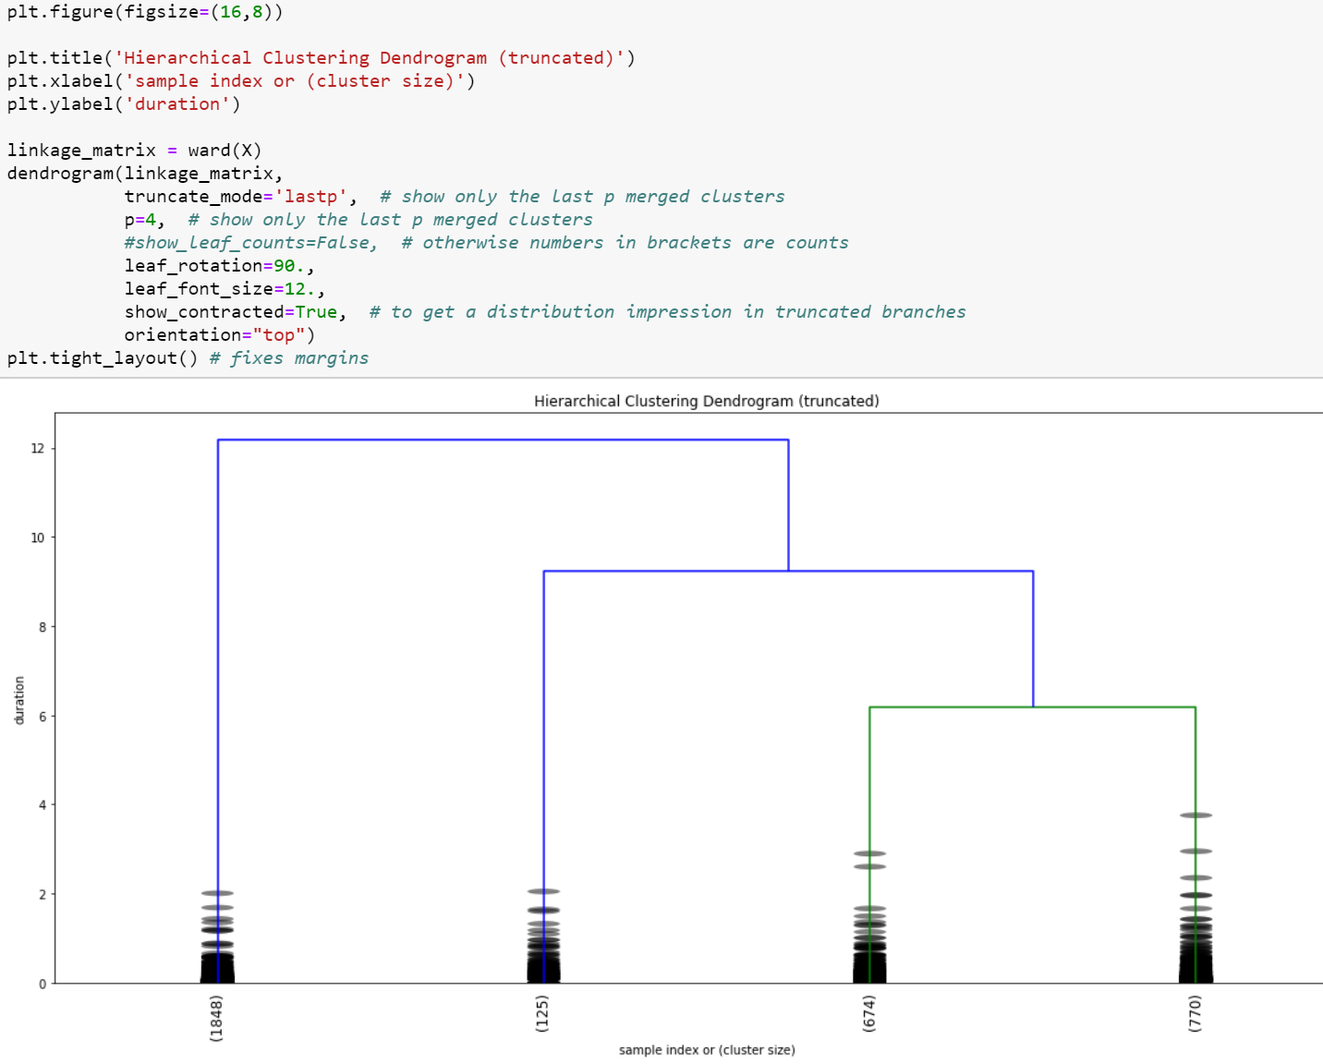
Clusters

Slide 26
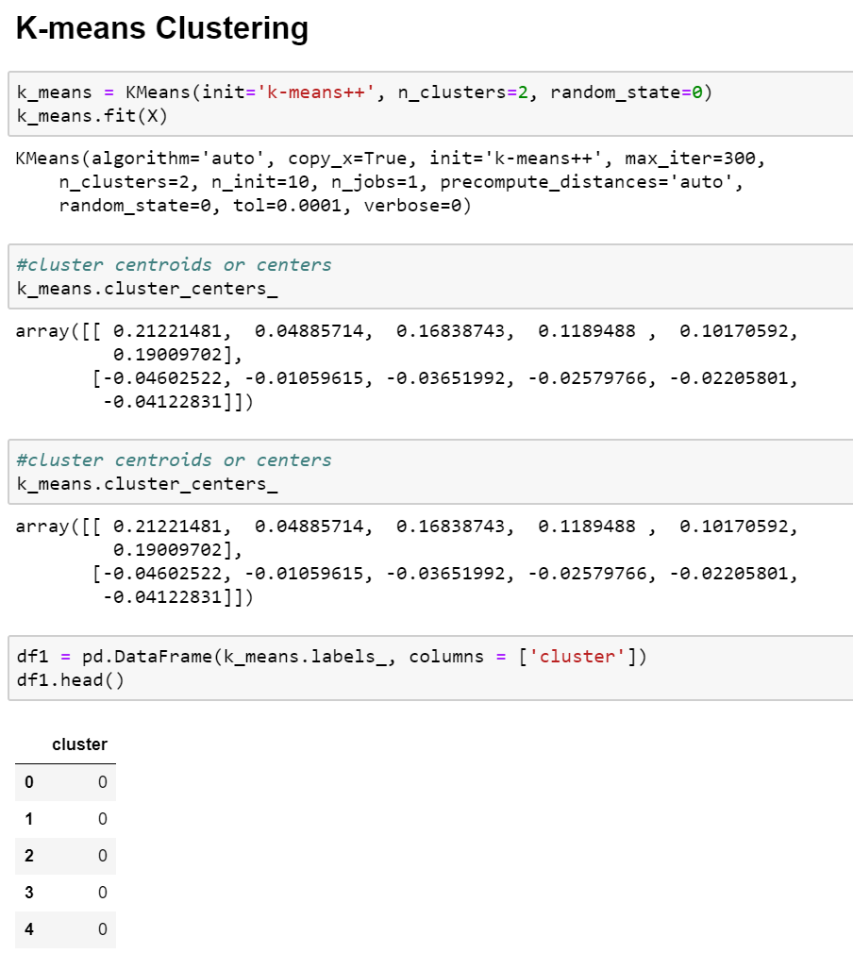
K Means

Slide 27
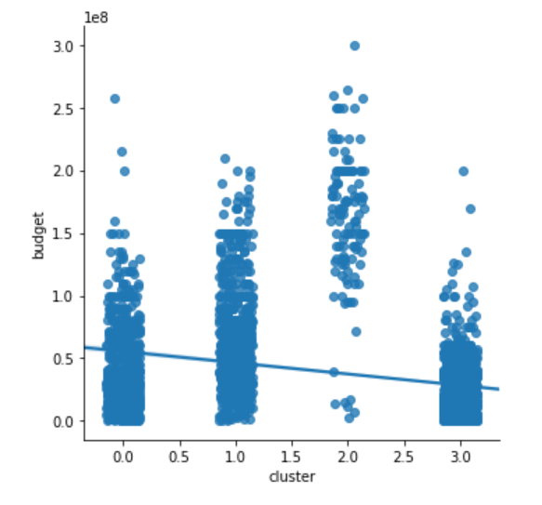
Budget within clusters

Slide 28
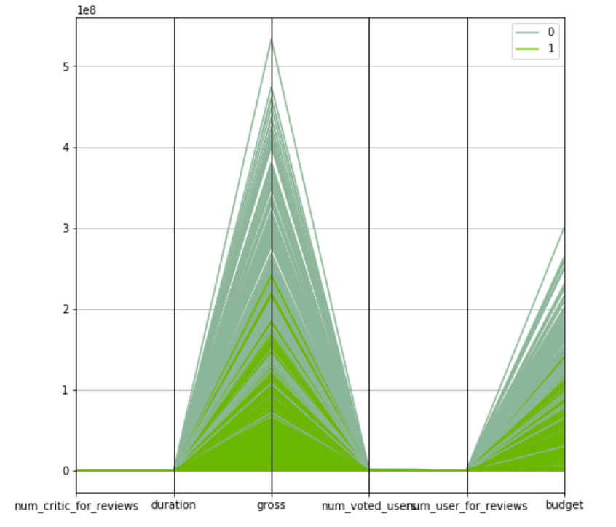
Gross and Budget in binary clusters

Slide 29
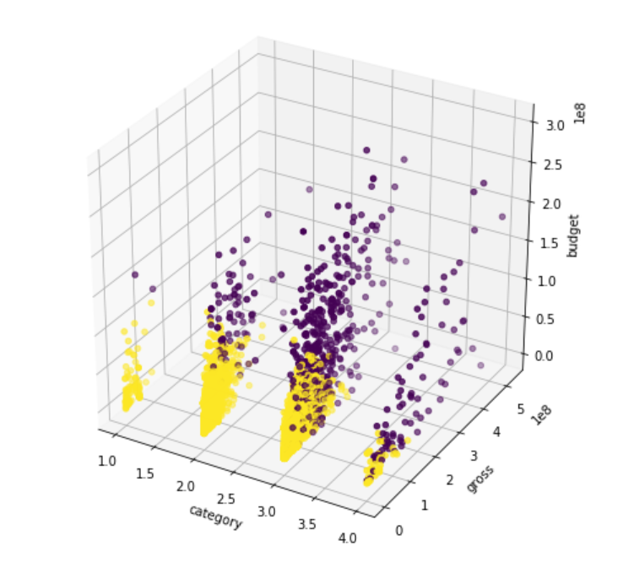
Gross in 4 categorys

Slide 30
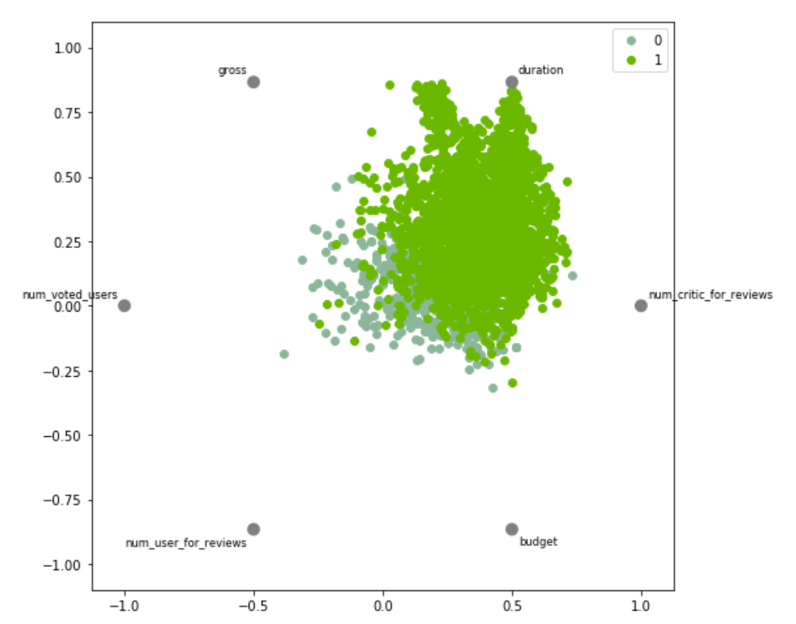
Conjoint analysis

Slide 31
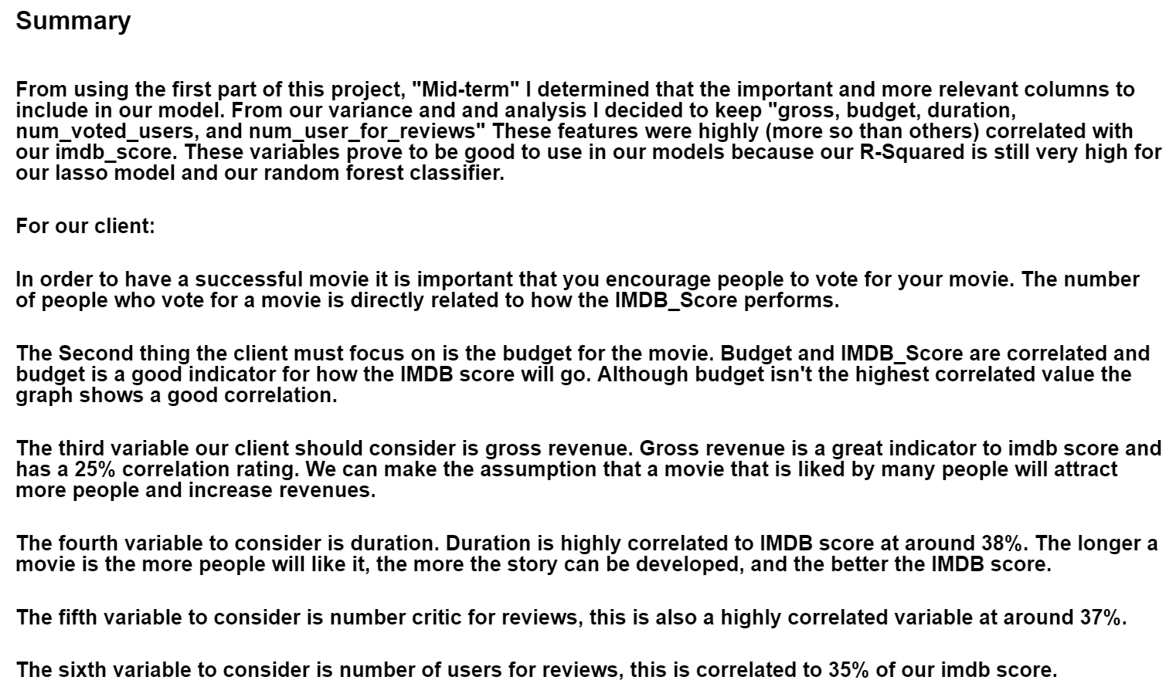
Project Summary

